Slide 1


BY
GANGADHARA REDDY
BHARATH REDDY

Slide 2
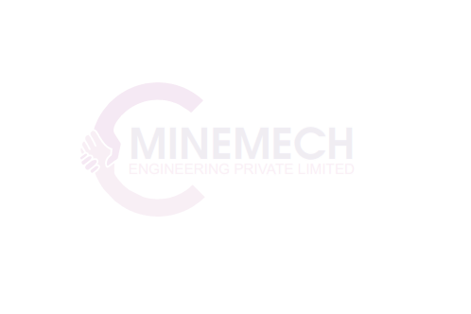
Our Team
L.B. Gangadhara Reddy – Director
He is graduated from Anna University, Chennai with degree in DME and B.E. (Mech.). With well-versed experience working in various leading construction equipment companies namely Gmmco, Putzmeister, JCB at multiple challenging positions.
To fulfil enterpreneur dreams started his own venture in 2012. He has earned solid reputation in executing many prestigious Civil & infrastructure projects through his execution skills, commitment & customer orientation.

Slide 3
Our Team
D. Bharath Reddy – Director
He is graduated from JNTU University, Hyderabad with degree in B.Tech (E.C.E). After working as a software developer for few years, he started a company Ingens Coal Pvt Ltd with a small team which deals in trading Imported Coal with many clients in Cement, Power, Pharma, Steel and other industries.
He handled leading Coal business with importers like Adani, Tata, Bhatia, Coastal energy to name a few in procuring Coal based on client requirements. He also diversified into residential apartment construction at Tirupati and Hyderabad

Slide 4
Our strengths
Our Experience & Technical Strengths - We have
Good experience in execution of Infrastructure projects like Construction of buildings, Irrigation, Roads, under ground drainage, drinking water supply schemes and railway works.
Good understanding of customer requirements and ability to provide viable solutions
Very good relations with Corporate, Semi corporate and RMC companies and Contractors
Good knowledge on ongoing & upcoming various projects
Good knowledge and track record in AP CE Industry.

Slide 5
Our Vision & Mision
VISION
“A premier infrastructure company that builds value through innovation and next practices and seeks to grow by caring and sharing”
MISSION
“To be the company of best choice in the Infrastructure Industry”

Slide 6
Our Values
OUR VALUES
Execution is strategy
Adoptability to New Technologies
Transparency and professionalism at workplace
No to bureaucracy
Strict Quality and Safety Measures
Integrity
Planning and implementation
Openness for discussions
Teamwork - Leadership through friendly culture

Slide 7
Works ongoing
SN | DESCRIPTION (RMC DIVISION) | YEAR | VALUE (in Cr)
01 | Project : Concrete Mixing & Transport, Velugodu Principal Contractor : Raghava Constructions | 2020 | 2.8
02 | Project : Concrete Mixing & Transport, Rajahmundry Principal Contractor : Venkata Krishna Constructions Pvt. Ltd (Our sister company) | 2020 | 4.1
03 | Project : Concrete Mixing & Transport, Warangal Principal Contractor : Sri Srinivasa Constructions | 2021 | 3.2
04 | Project : Concrete Mixing & Transport, Hyderabad Pricipal Contractor : EIPL Constructions | 2021 | 10.1

Slide 8
Works ongoing
SN | DESCRIPTION (CIVIL DIVISION) | YEAR | VALUE (in Cr)
01 | Project : Storm water Drains executed by VKC pvt Ltd (our sister company), AMRUT scheme, Rajamundry Principal Contractor : Sudhakara Infra Pvt Ltd | 2020 | 29
 | DESCRIPTION (CRUSHING DIVISION) | CAPACITY
01 | Project : Drilling, Blasting, Loading, Transport, Crushing and screening, Kalahasti | 200 TPH 2 Stage plant
02 | Project : Drilling, Blasting, Loading, Transport, Crushing and screening, Anakapalli, Vizag | 250 TPH 3 Stage with washing plant
03 | Project : Drilling, Blasting, Loading, Transport, Crushing and screening, Padmanabham, Vizag | 250 TPH 3 stage plant
04 | Project : Mining and Crusher OMC for railway work, Vinukonda | 350 TPH 2 Stage plant

Slide 9
Works Completed
SN | DESCRIPTION | YEAR | VALUE (in Cr)
01 | Project : Chambal Right Main Canal Lining, Sabalgarh, Madhya Pradesh Principal Contractor : Prasad & Company | 2014 | 12
02 | Project : Railway Embakment, Warangal Principal Contractor : Sudhakara Infra Private Ltd | 2015 | 2
03 | Project : Kakatiya Canal Lining, Warangal Principal Contractor : Sudhakara Infra Private Ltd | 2015 | 4.5
04 | Project : Pipeline Work, Mahbubnagar Principal Contractor : IHP | 2016 | 3.5
05 | Project : Gabion Structure, Vijayawada Pricipal Contractor : Rockiera Engineering | 2017 | 3.2
06 | Project : Indian Air force G+7 residential building, Mysore Principal Contractor : GJS Constructions | 2017 | 2.5
07 | Project : Polavaram Right Main Canal 6th Package Lining Principal Contractor : RSV Constructions | 2017 | 8.2
08 | Project : RVNL, 3rd Line Railway work at Vijayawada - Tenali Principal Contractor : GR Infra | 2018 | 5.1
09 | Project : PPM Concrete Roads, GHMC Hyderabad Principal Contractor : Sudhakara Infra Private Ltd | 2019 | 14.8

Slide 10
Plant & machinery
SN | EQUIPMENT DESCRIPTION | QTY
01 | CONMAT BATCHING PLANT M30 | 1
02 | CONMAT BATCHING PLANT CP60 | 1
03 | AQUARIUS BATCHING PLANT BP60 | 1
04 | MACONS BATCHING PLANT M25 | 1
05 | UNIVERSAL BATCHING PLANT M60 | 1
06 | TRANSIT MIXERS 7CUM | 12
07 | CONCRETE PUMPS | 4
08 | BACKHOE LOADERS | 4
09 | EXCAVATORS | 3
10 | TIPPERS | 6
11 | DEWATERING PUMPS | 8
12 | GENERATORS | 4
13 | TRACTORS & TANKERS | 3

Slide 11
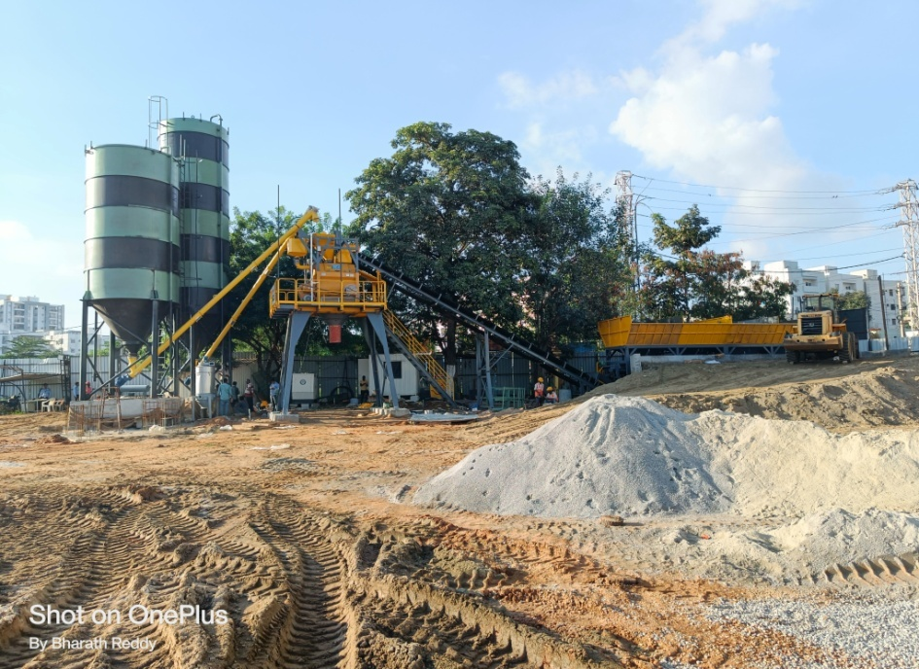
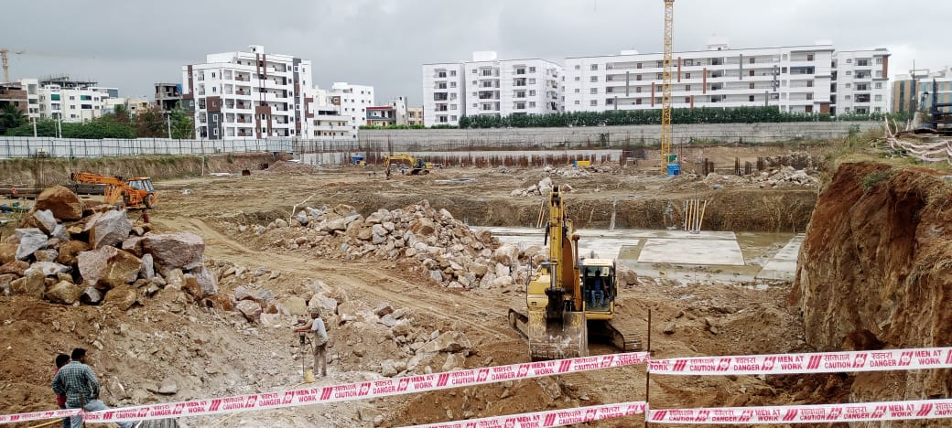
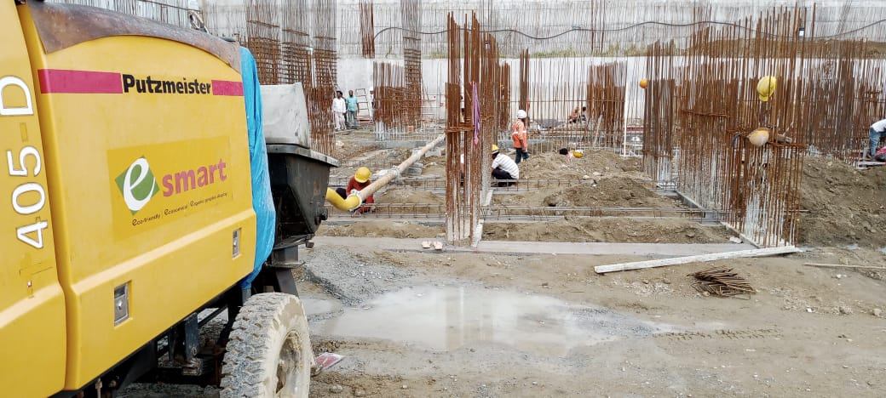
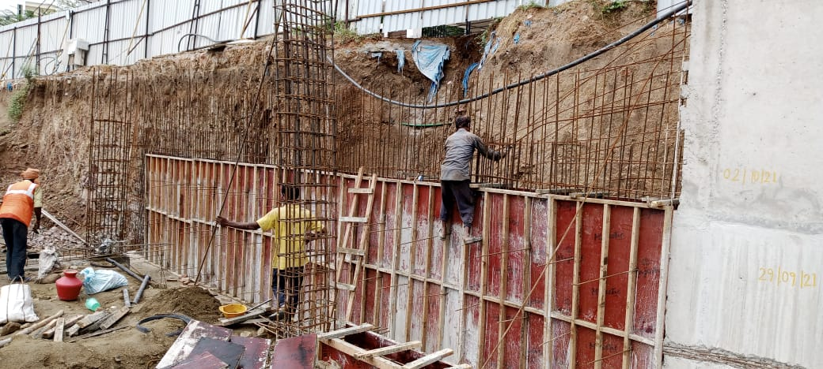
eipl hyderabad

Slide 12
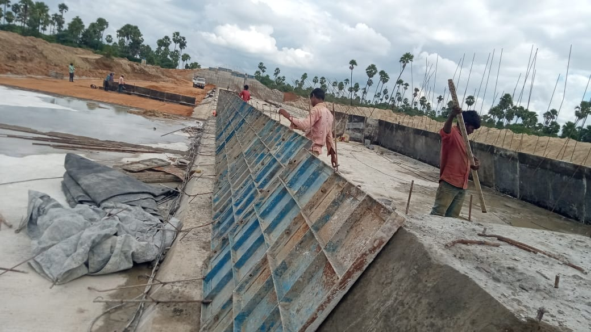
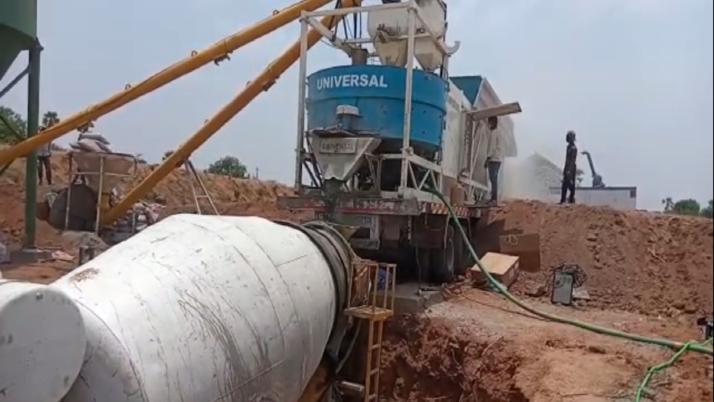
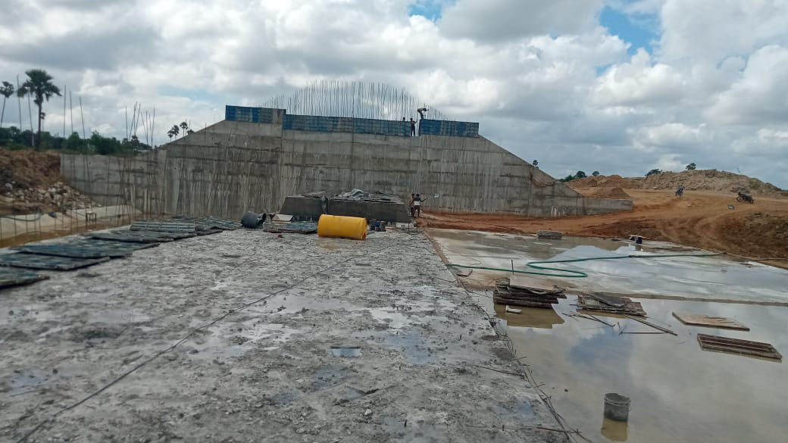
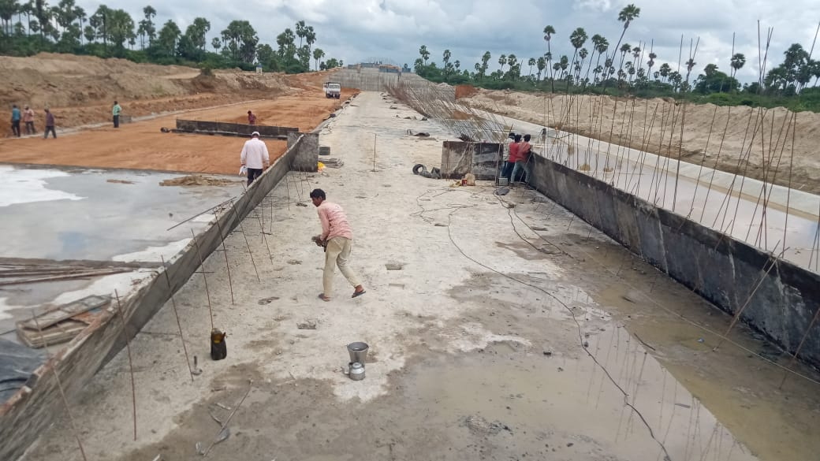
nahakal tank uppugal

Slide 13
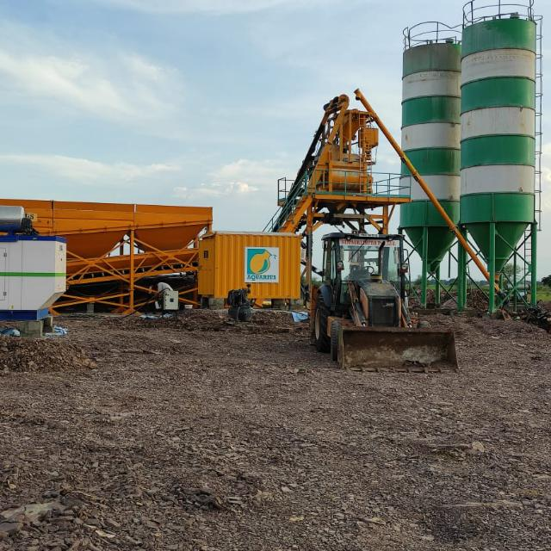
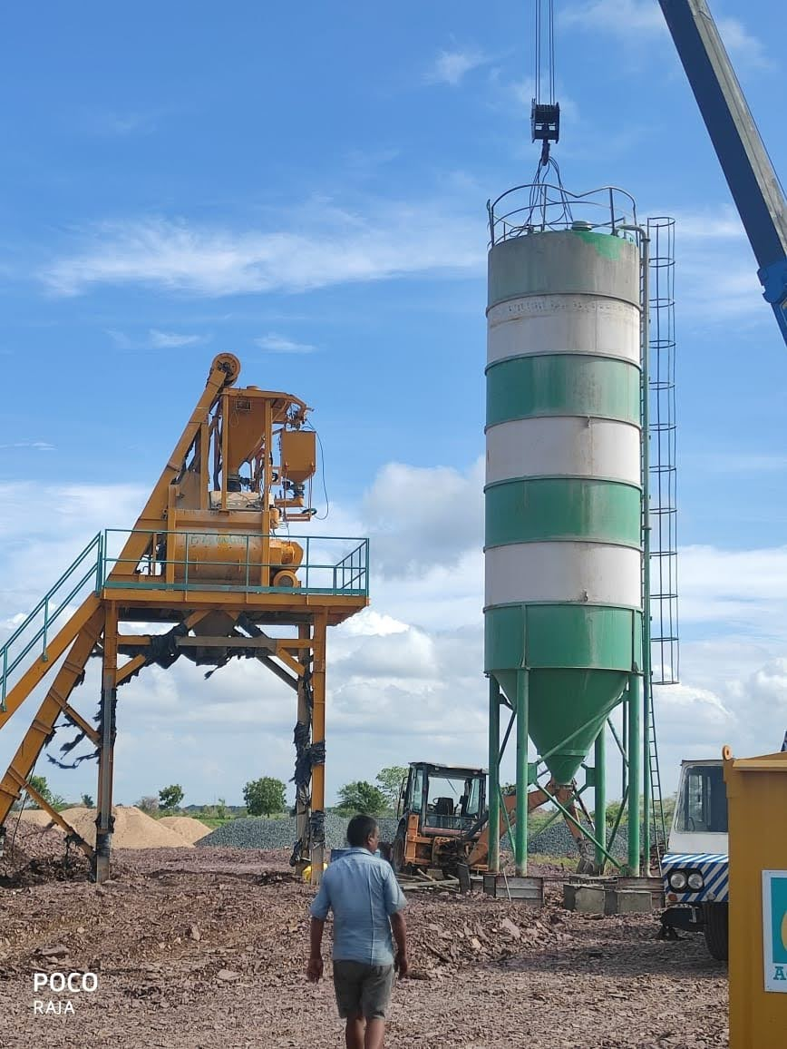
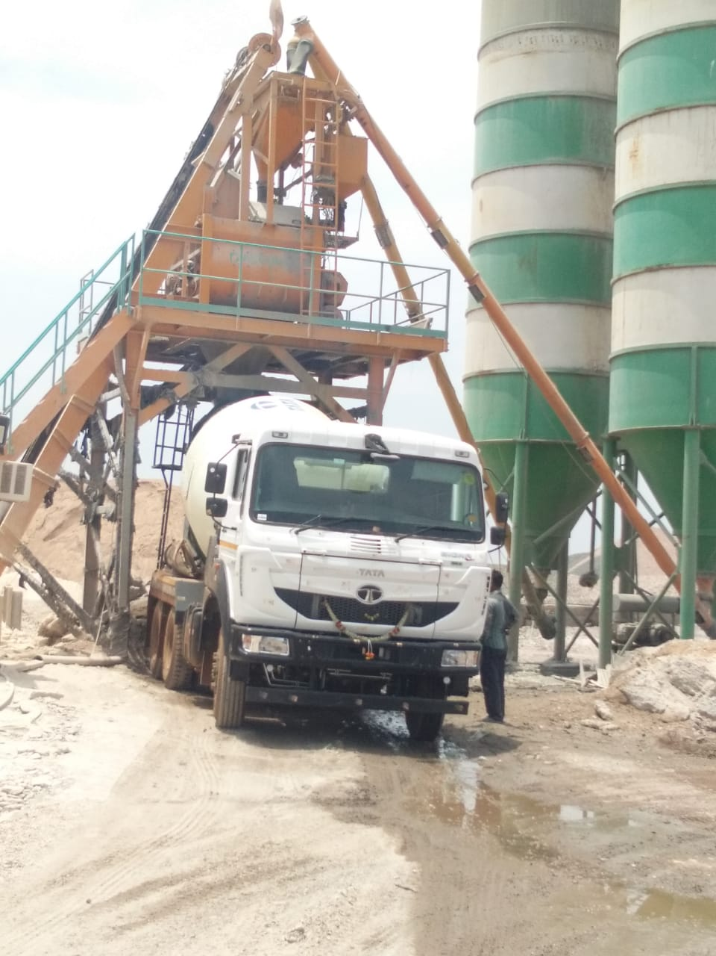
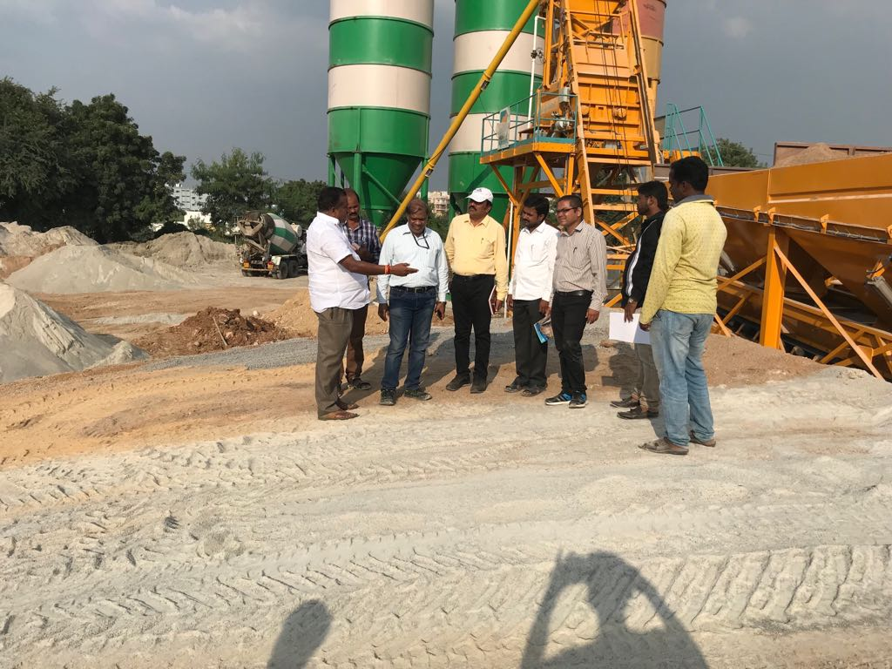
Tgp link velugodu

Slide 14
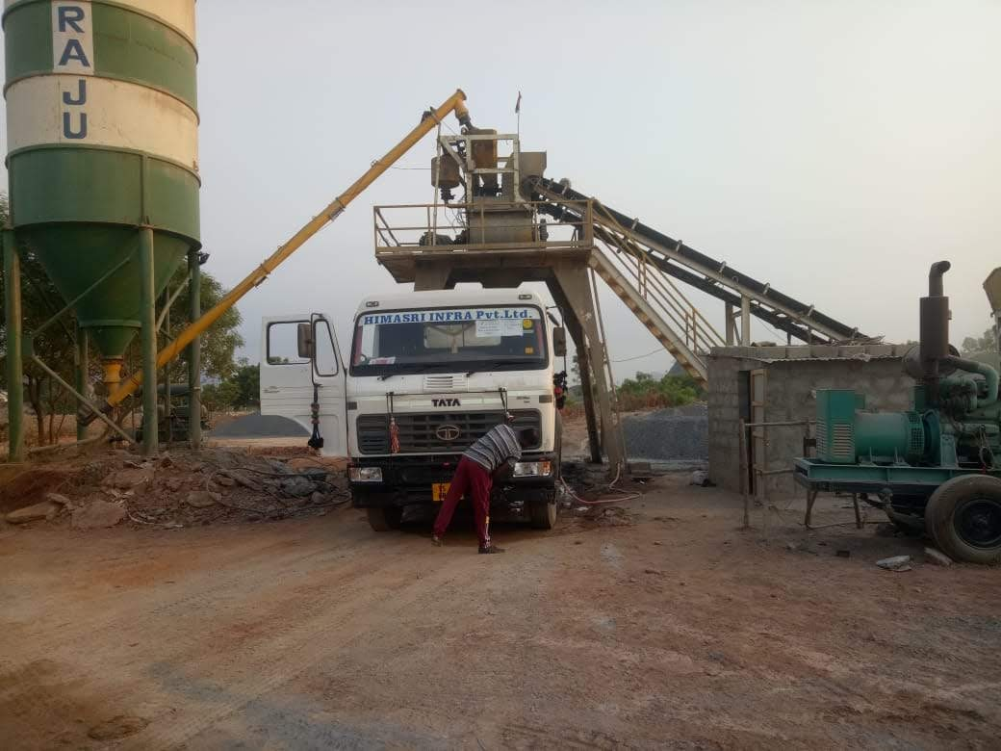
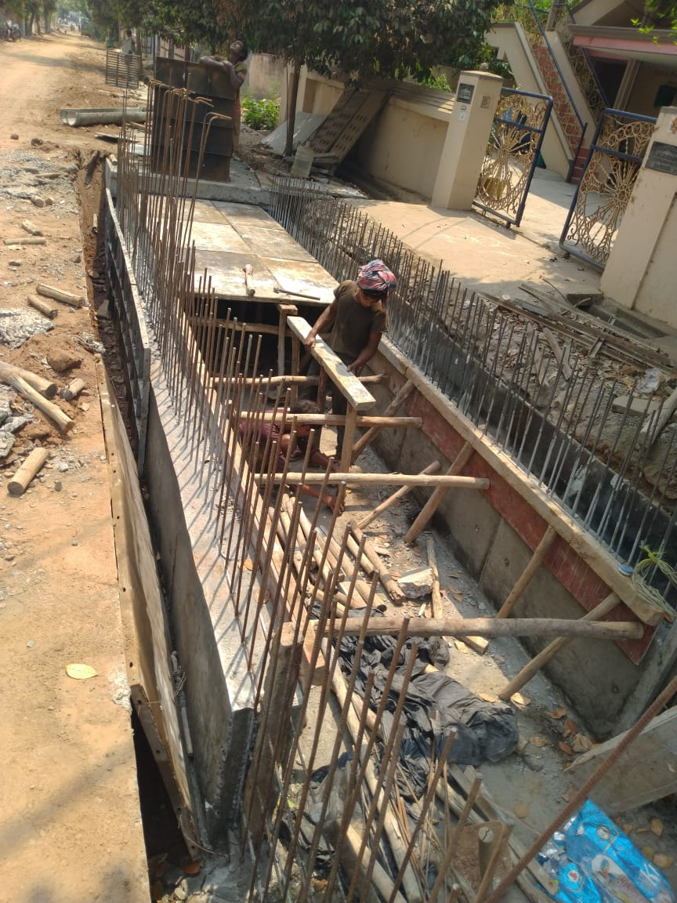
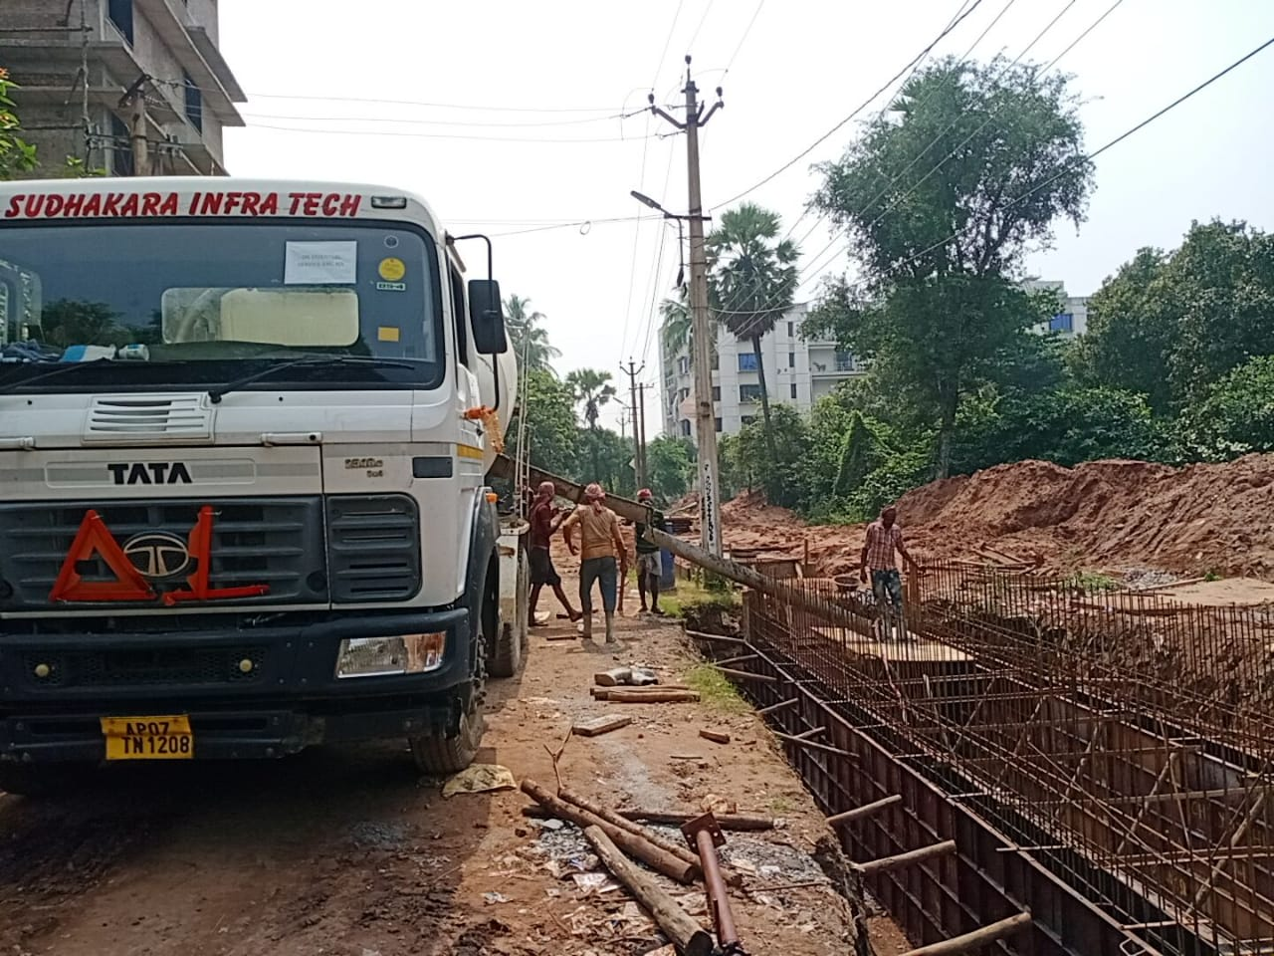
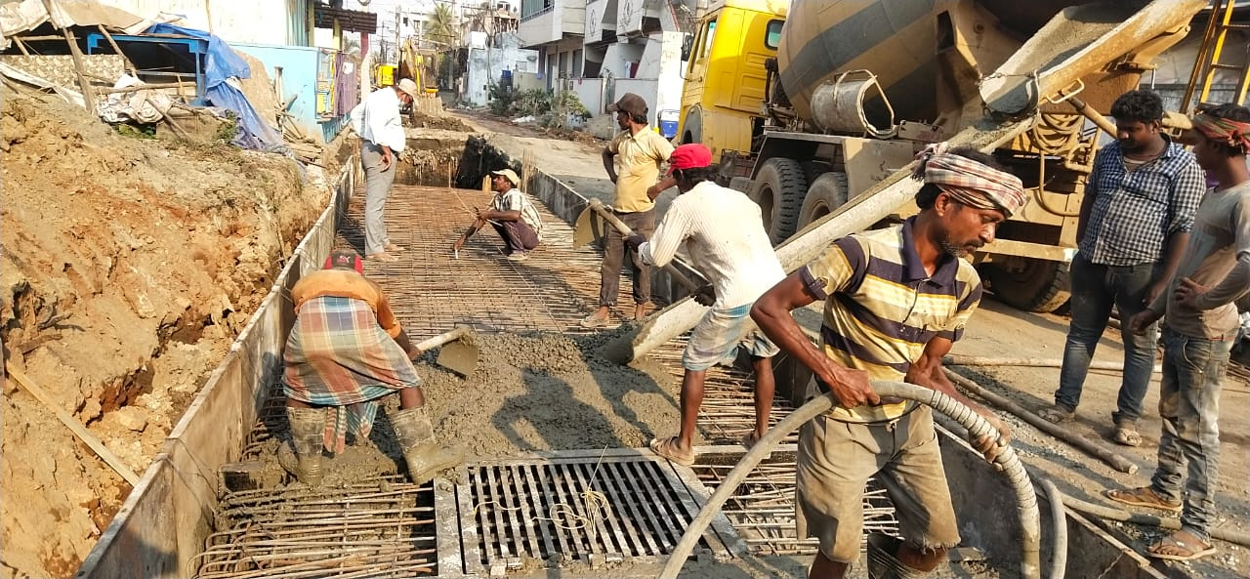
Amrut drains rajahmundry

Slide 15
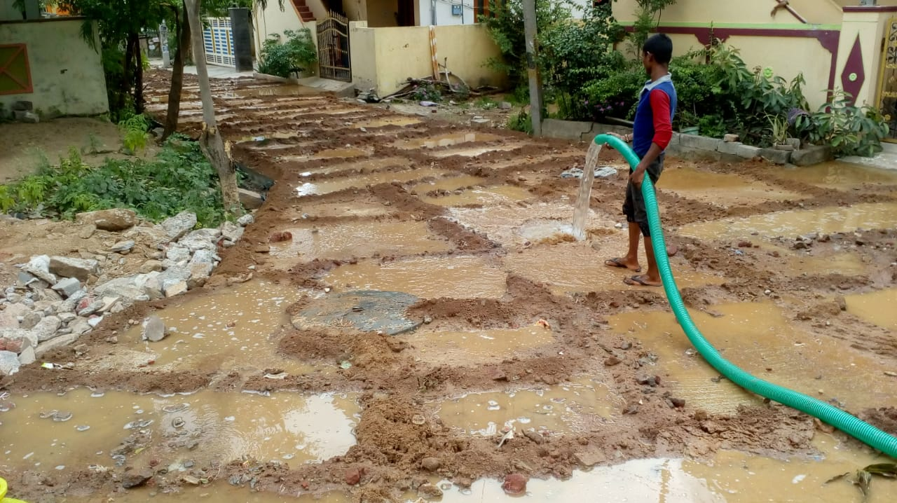
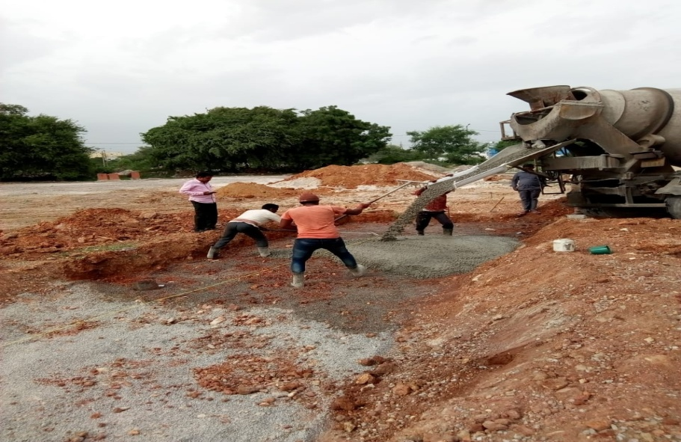
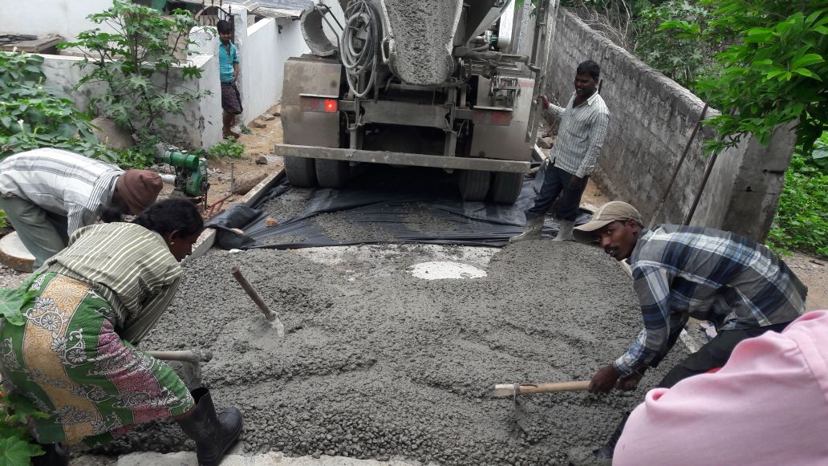
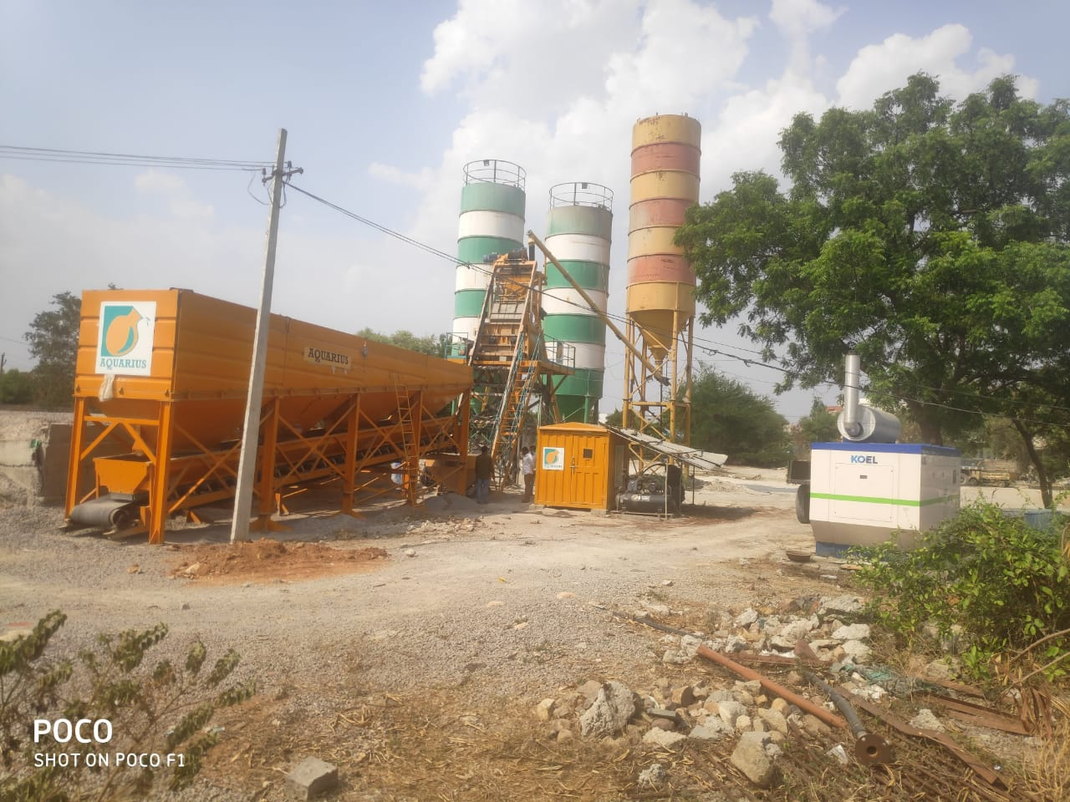
CC Roads Ghmc hyderabad

Slide 16

Thank You
SUCCESS IS A PROJECT THAT IS ALWAYS UNDER CONSTRUCTION
Minemech Engineering Private Limited
Regd Off: #112, Bhanu Enclave, Sunder Rao nagar, Hyderabad
Email: minemechindia@gmail.com
Ph: 9866 777 455 | 9966 000 599

